Slide 1
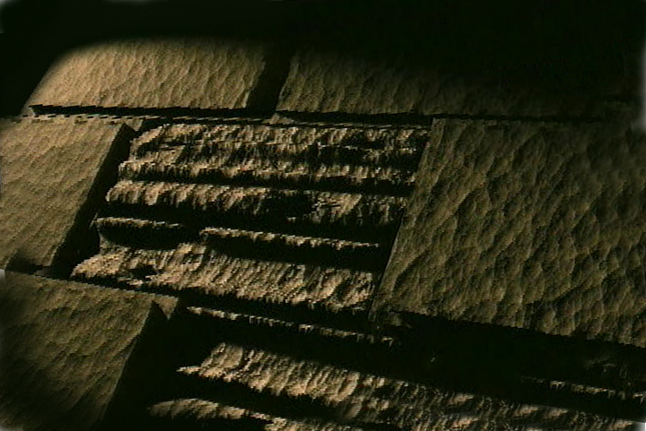
Syllabus
THE BIBLE... BASICALLY
©2006 TBBMI
Designed by Dr. John Fryman, Texas, USA Taught by Dr. Rick Griffith, Singapore Bible College All files in many languages for free download at BibleStudyDownloads.org

Slide 2
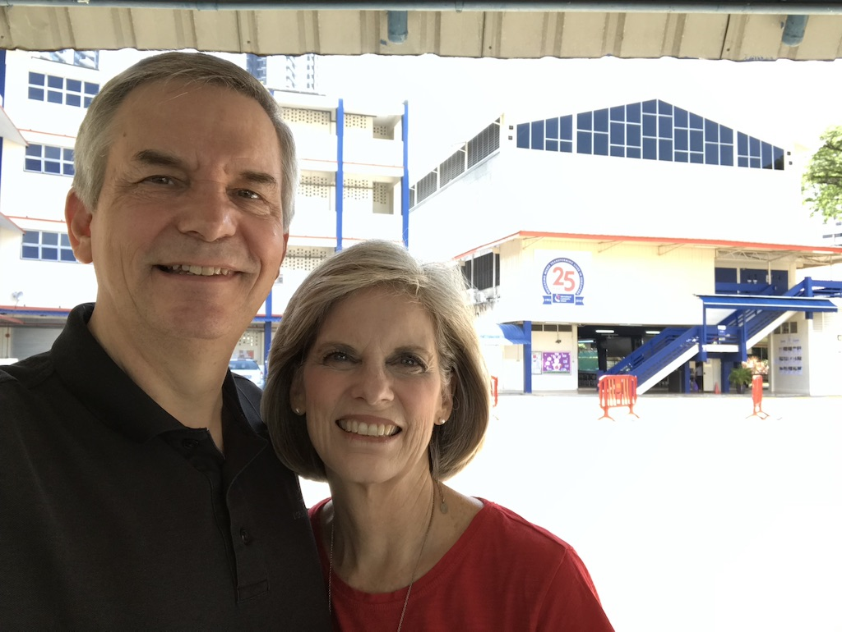

Slide 3
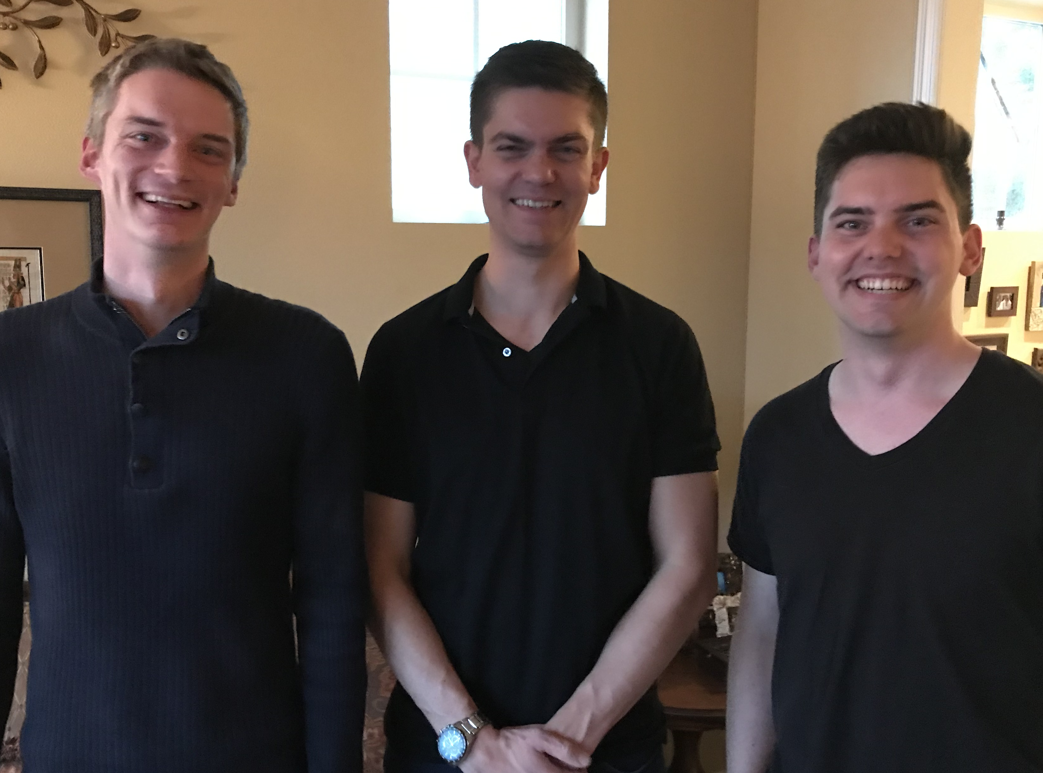
Our Three Sons

Slide 4
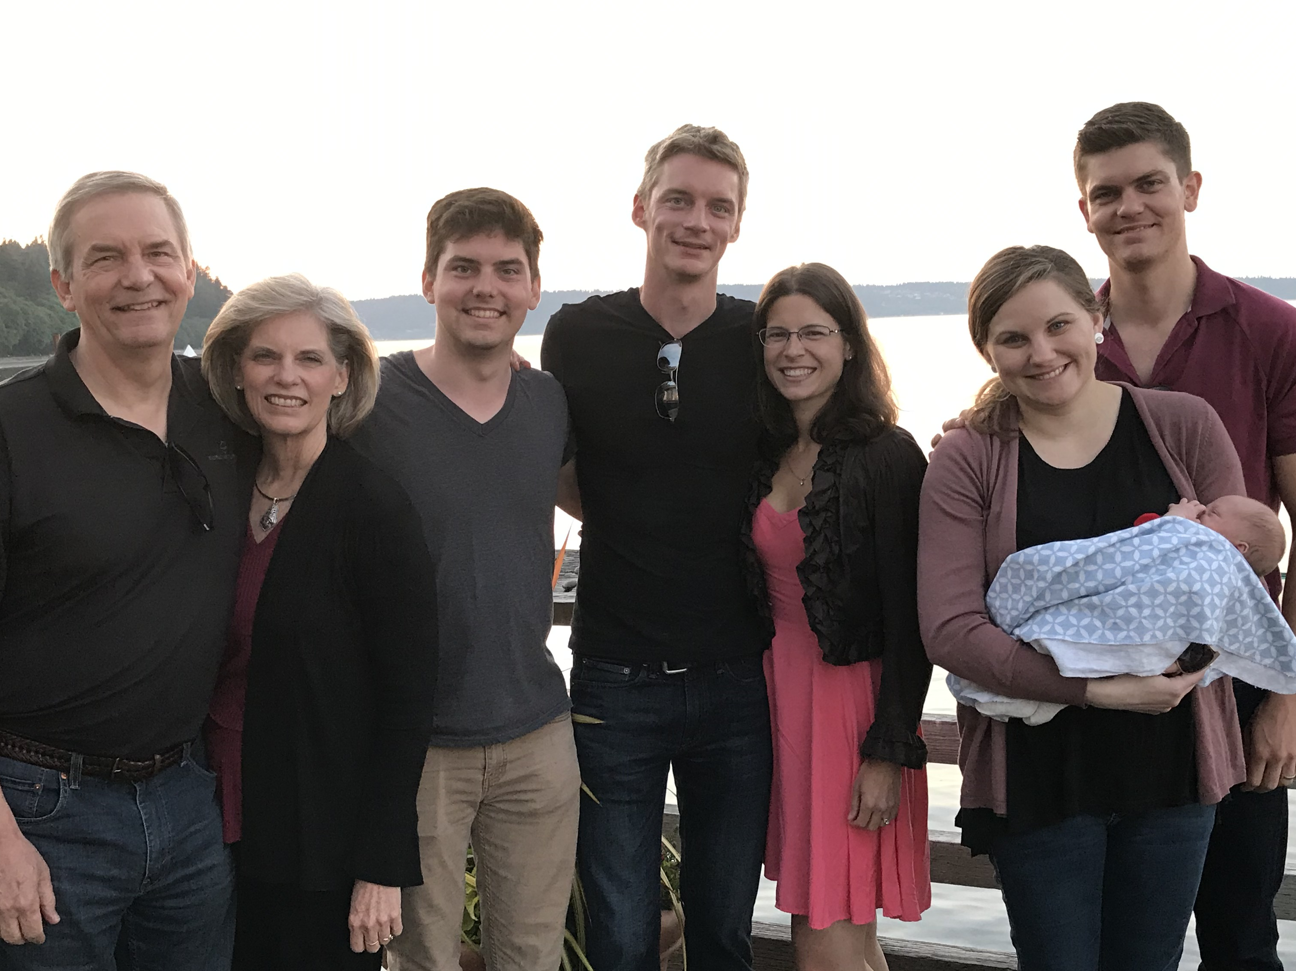
The Griffiths 31 May 2019
2019
Rick & Susan
John (26)
Kurt & Cara (31)
Stephen, Katie & Jesse (29)

Slide 5
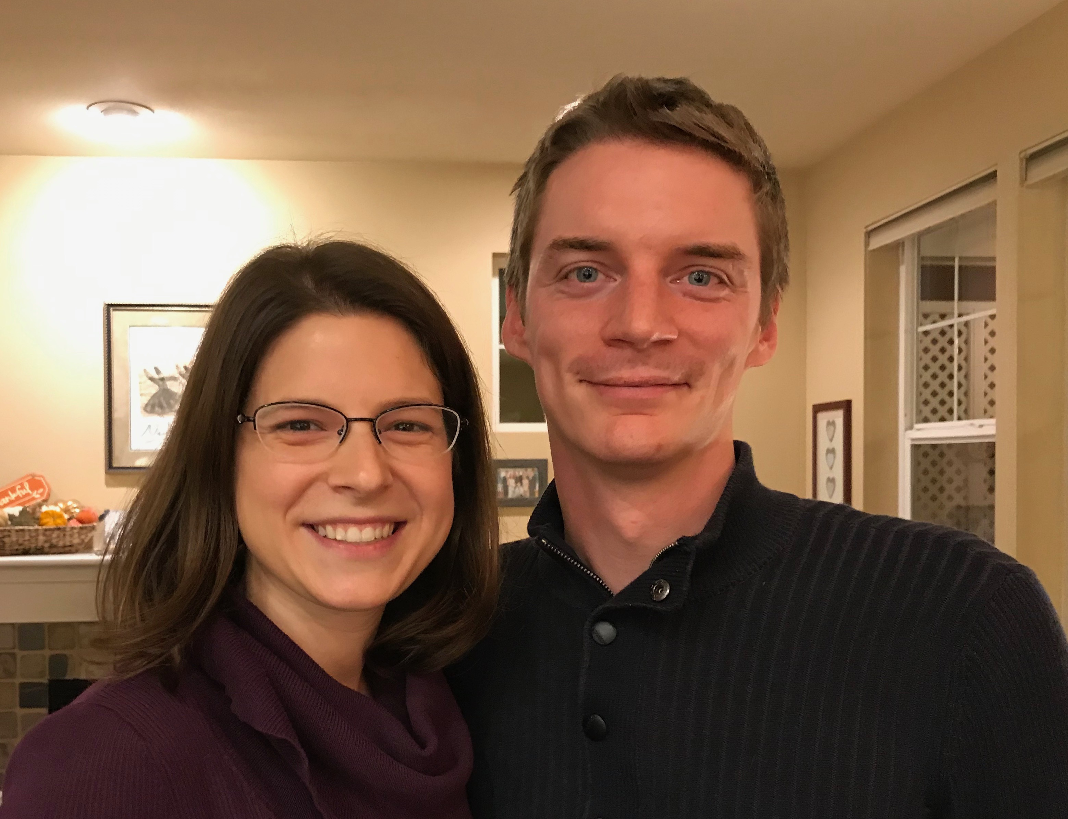
Kurt (32) and Cara are beginning a consulting business near Seattle
Notes:
Kurt and his wife Cara are in Seattle

Slide 6
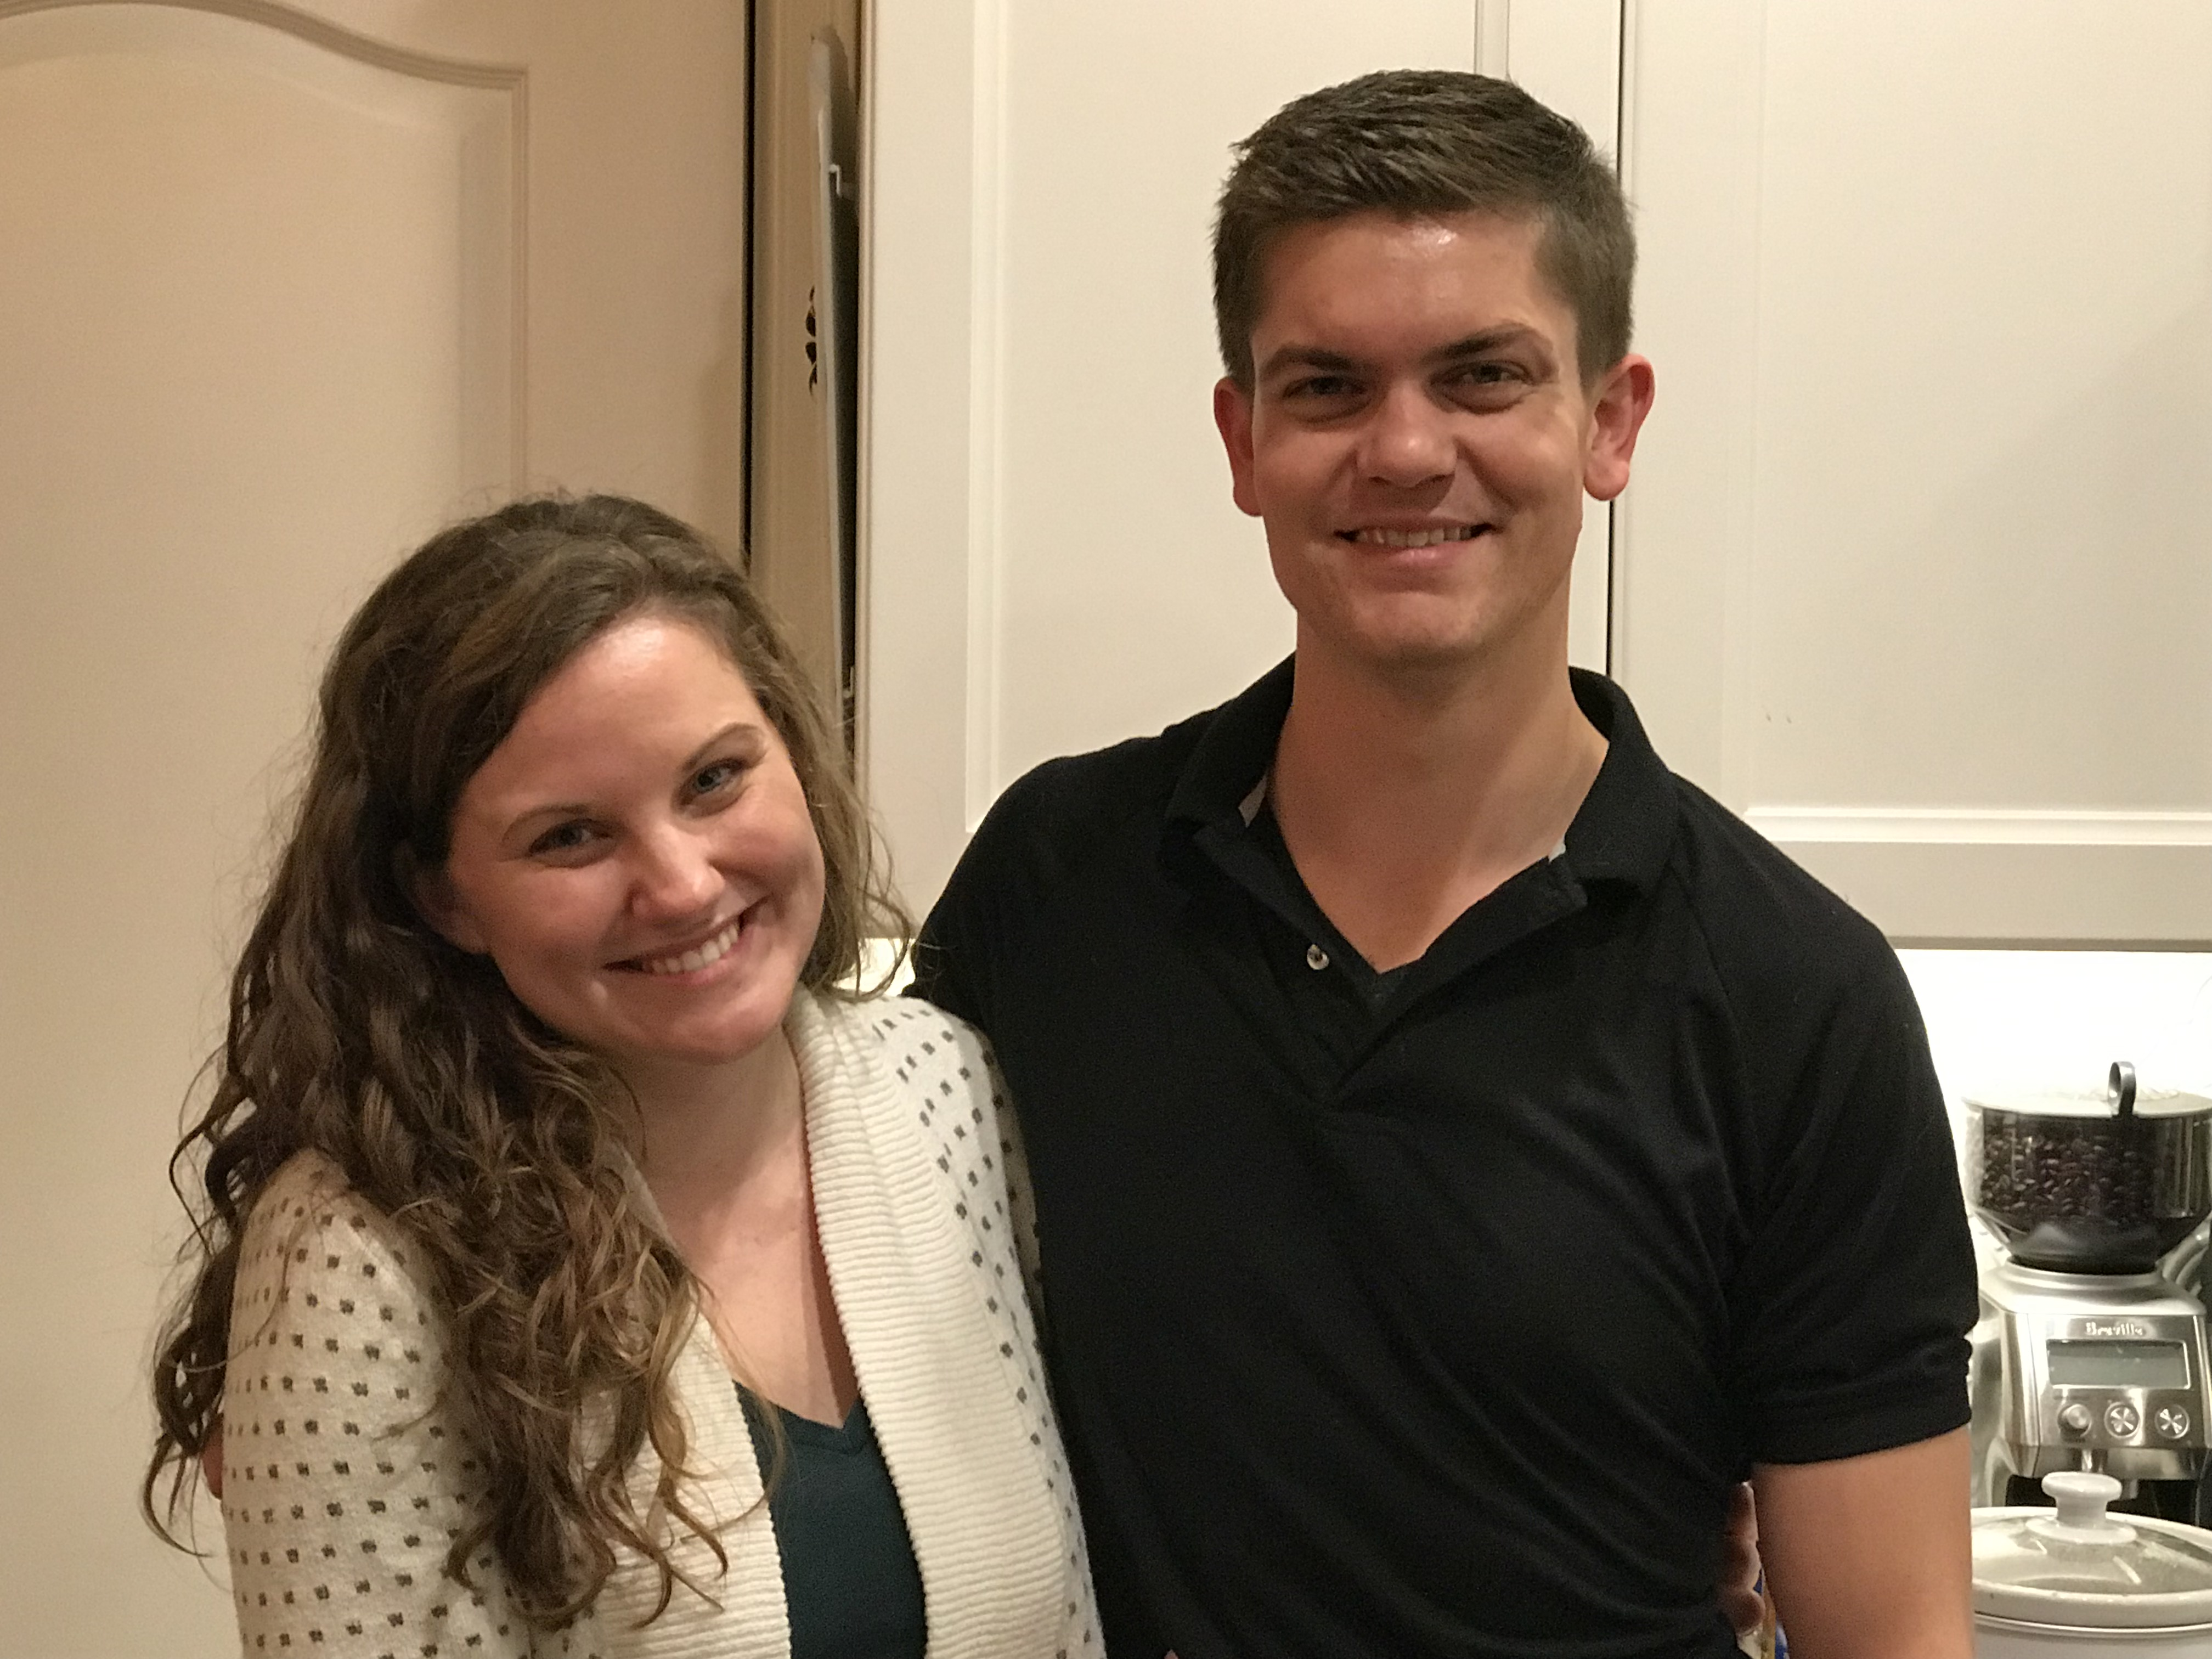
Stephen & Katie
6
Notes:
Stephen and his wife Katie in Boise

Slide 7
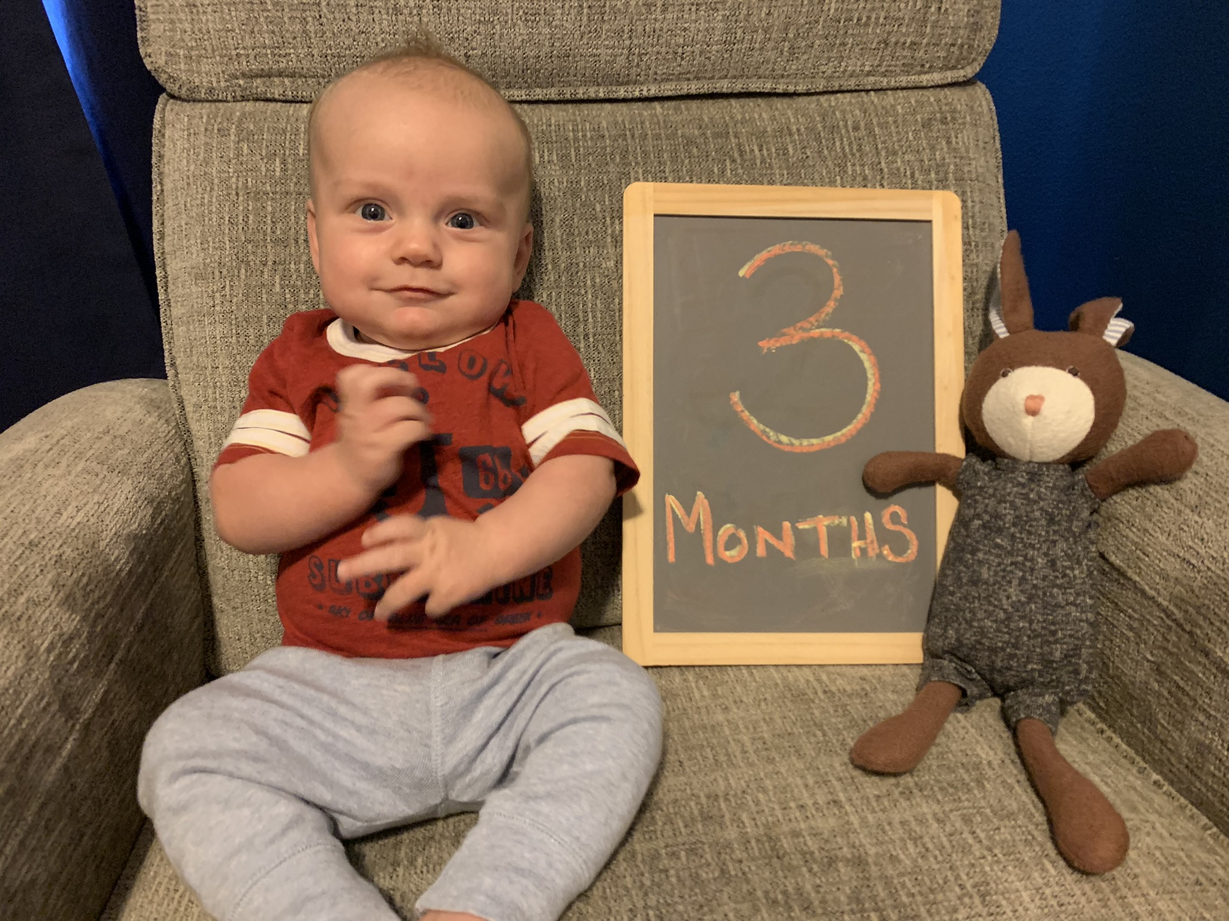
JESSE GRIFFITH BORN 14 MAY 2019

Slide 8
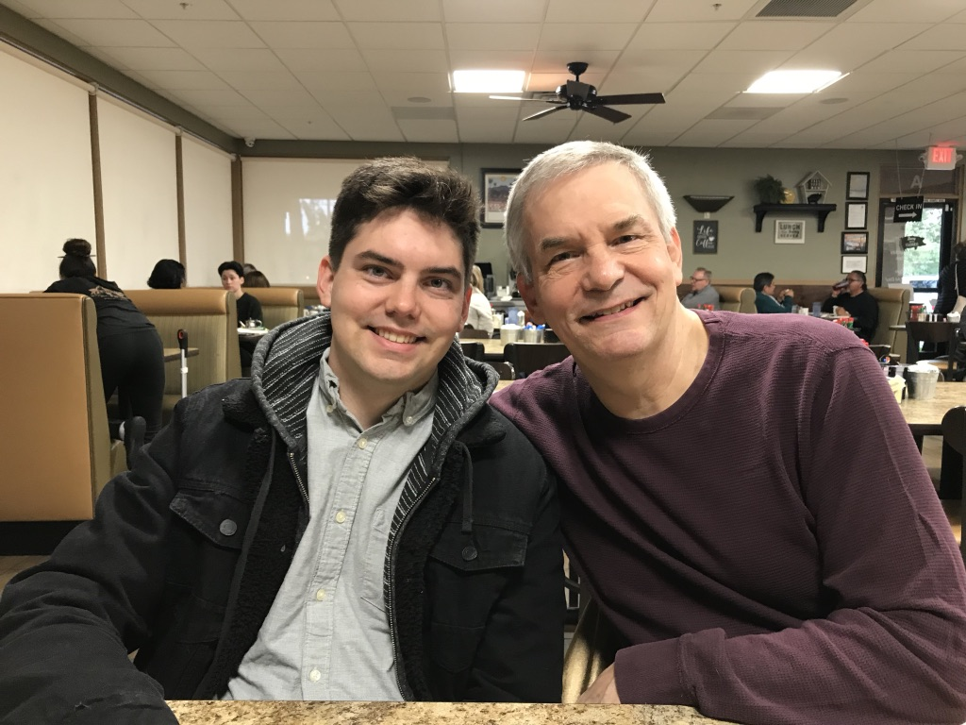
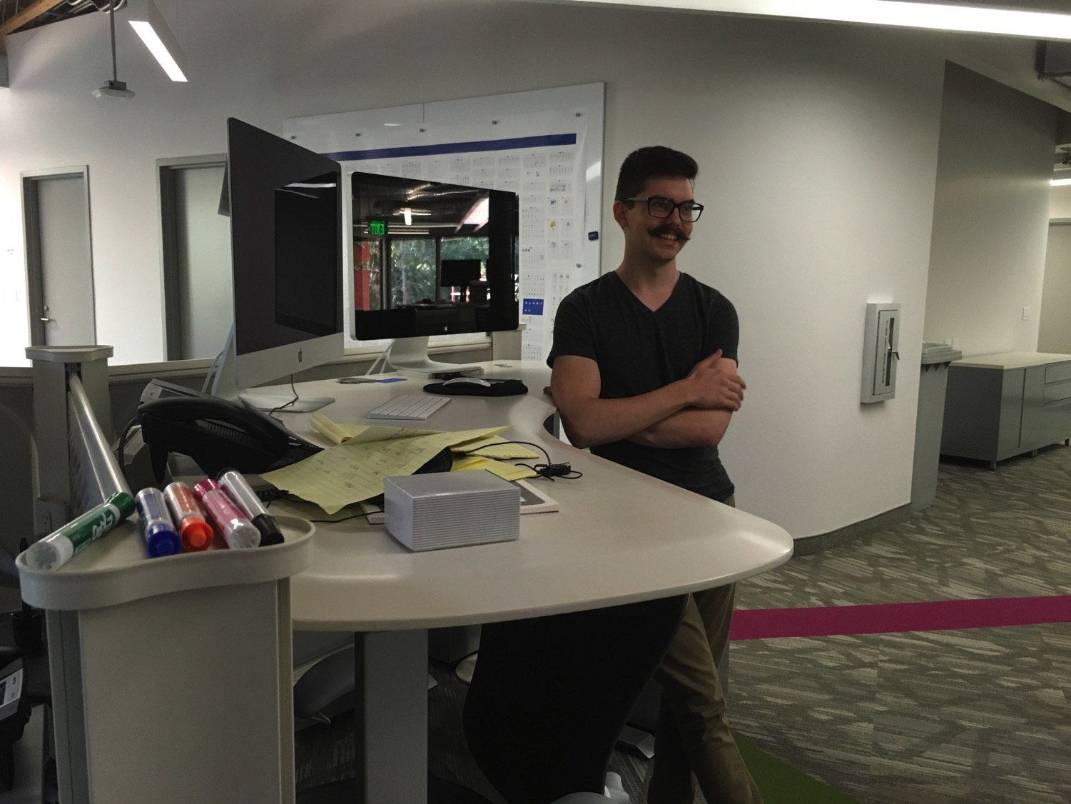
John (26) is a graphic artist in Redlands, California
8
Notes:
John just graduated from Biola and works for ESRI

Slide 9
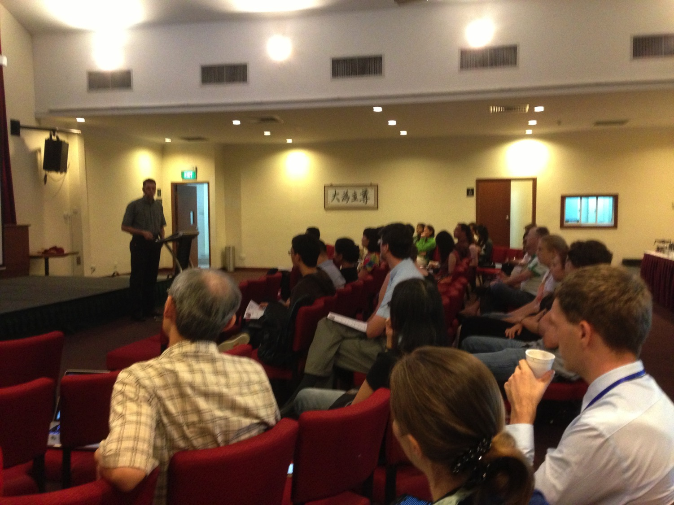
Our People
9
51 people from 11 nations
June 2019

Slide 10
Crossroads People • June 2019
UK
CHINA
JAPAN
UNITED KINGDOM
RUSSIA
NETHERLANDS
FRANCE
MONGOLIA
ITALY
KOREA
HONG KONG
LEBANON
JAPAN
TAIWAN
GERMANY
MYANMAR
CANADA
EGYPT
INDIA
USA
THAILAND
ETHIOPIA
MALAYSIA
ZIMBABWE
PHILIPPINES
SINGAPORE
INDONESIA
SOUTH AFRICA
CIC
NEW ZEALAND
AUSTRALIA
Notes:
Our June 2019 church of 51 people stem from 11 different countries around the world: Australia (David & Fiona), France (Aurelie), Korea (Grace Kim), India (Cynthia), Indonesia (Rena), Japan (Yoshie), Myanmar (Peng), Singapore (Albina), Thailand (Mae), UK (James & Gabi), USA (Miriam).
This does not include people who have recently attended only once: Dowon (Korea)
Nor does it include missionaries living back in their countries but still are members of CIC: Maple (Taiwan), Budmaa (Mongolia)
Previous: Canada (Gloria Lee), Ethiopia (Lele), Malaysia (Aston, Naomi), Netherlands (Dies & Desiree), Philippines (Micah), South Africa (Melody),

Slide 11
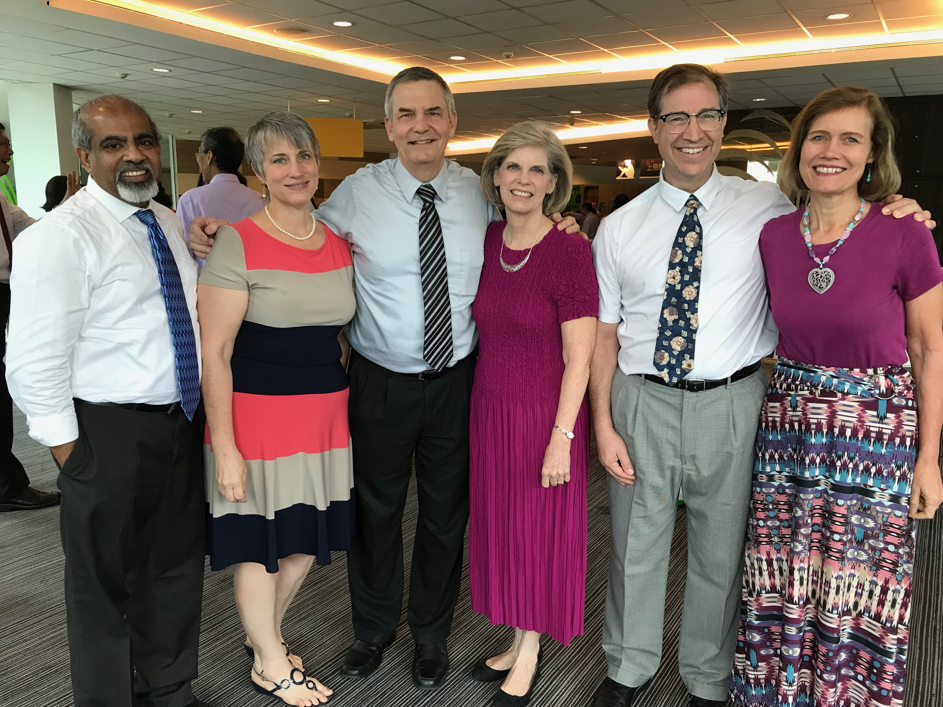
Church Elders
Andrew & Lori Spurgeon
Rick & Susan Griffith
Jim & Jacqui Harmeling
Notes:
11
11

Slide 12
www.cicfamily.com

Slide 13
www.cicfamily.com

Slide 14
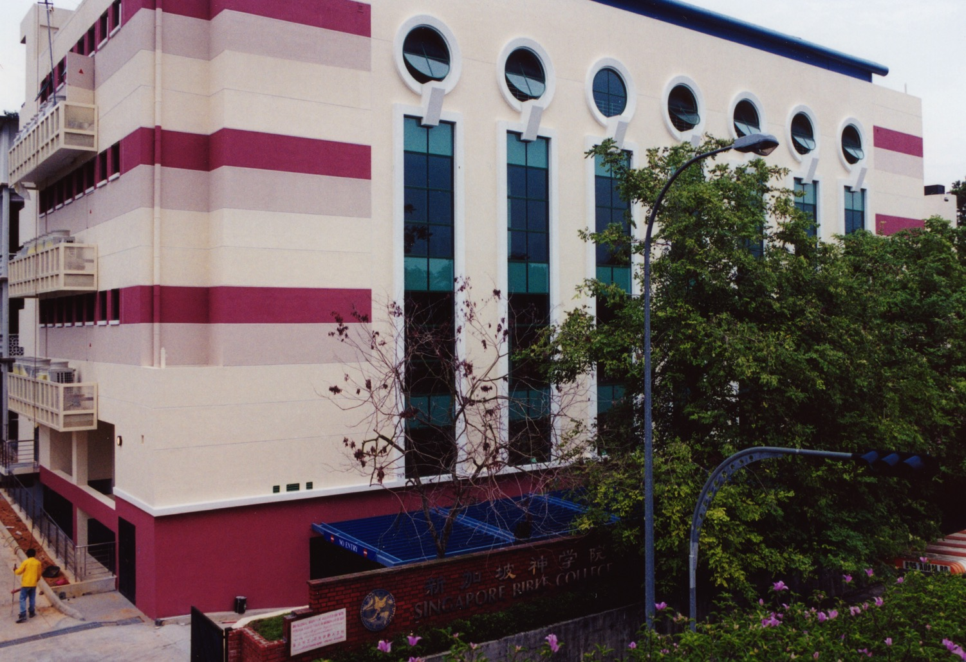
SINGAPORE BIBLE COLLEGE
9
Notes:
I've served as a seminary professor with 30 other faculty at Singapore's largest training school: Singapore Bible College

Slide 15
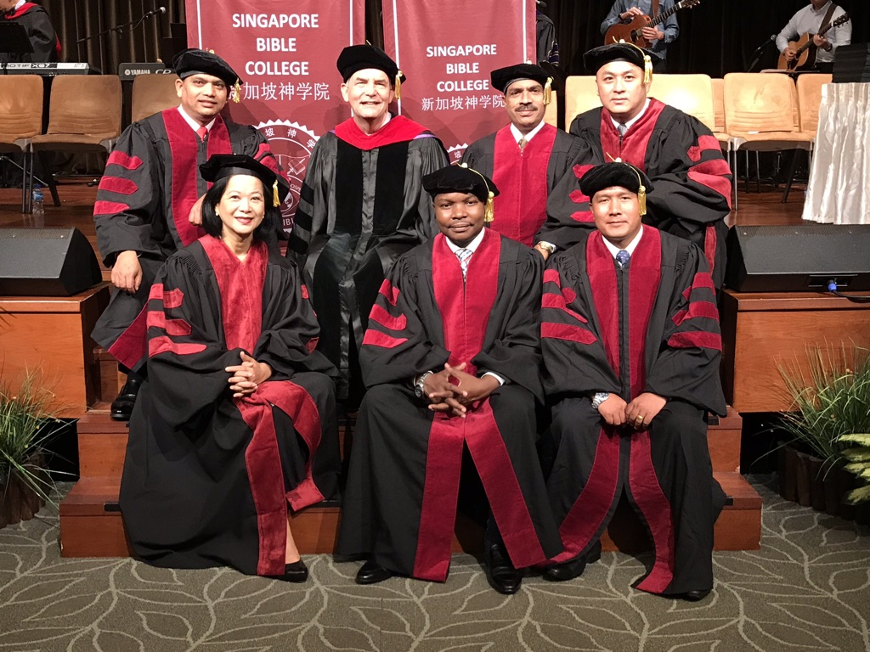
I direct the SBC Doctor of Ministry studies (DMin)
Notes:
I'm also the director of the doctoral program at SBC that trains about 80 seminary professors and pastors throughout Asia in English and Chinese. Generallly each year about 5 of them received their Doctor of Ministry degree.

Slide 16
SBC Courses I Teach
(English • Bahasa • Chinese)
Survey
OT NT
Backgrounds
WOT WNT
Theology
Church Spirit Future
Preaching
Homiletics 1 Homiletics 2
Notes:
I get to teach these leaders every book of the Bible in survey courses, plus backgrounds to both the OT and NT, three areas of theology, and how to preach.

Slide 17
Assignment File System

Slide 18
The Bible…Basically link at BibleStudyDownloads.org
Get this presentation for free!
Notes:
The Bible…Basically (bb)

Slide 19
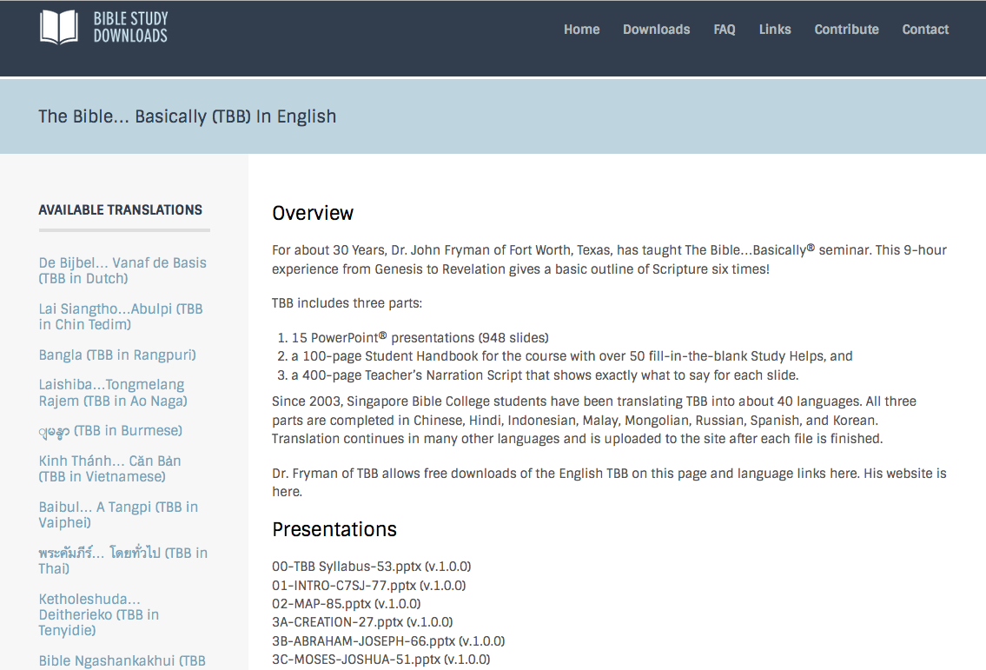
English
BibleStudyDownloads.org

Slide 20
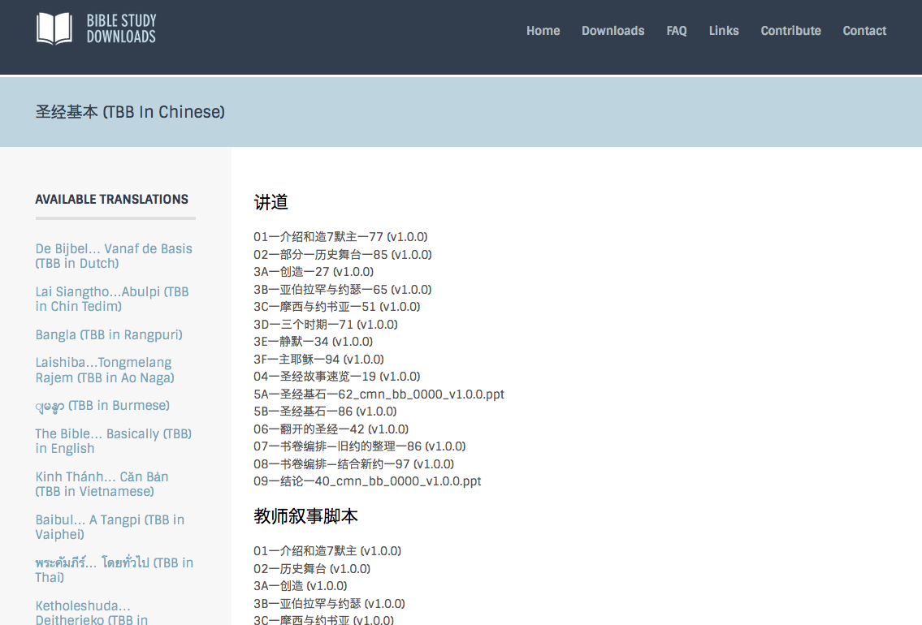
Chinese
BibleStudyDownloads.org

Slide 21
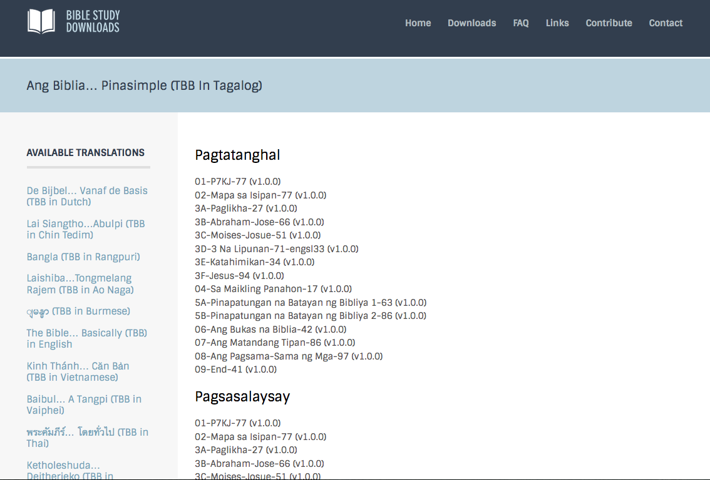
Tagalog
BibleStudyDownloads.org

Slide 22
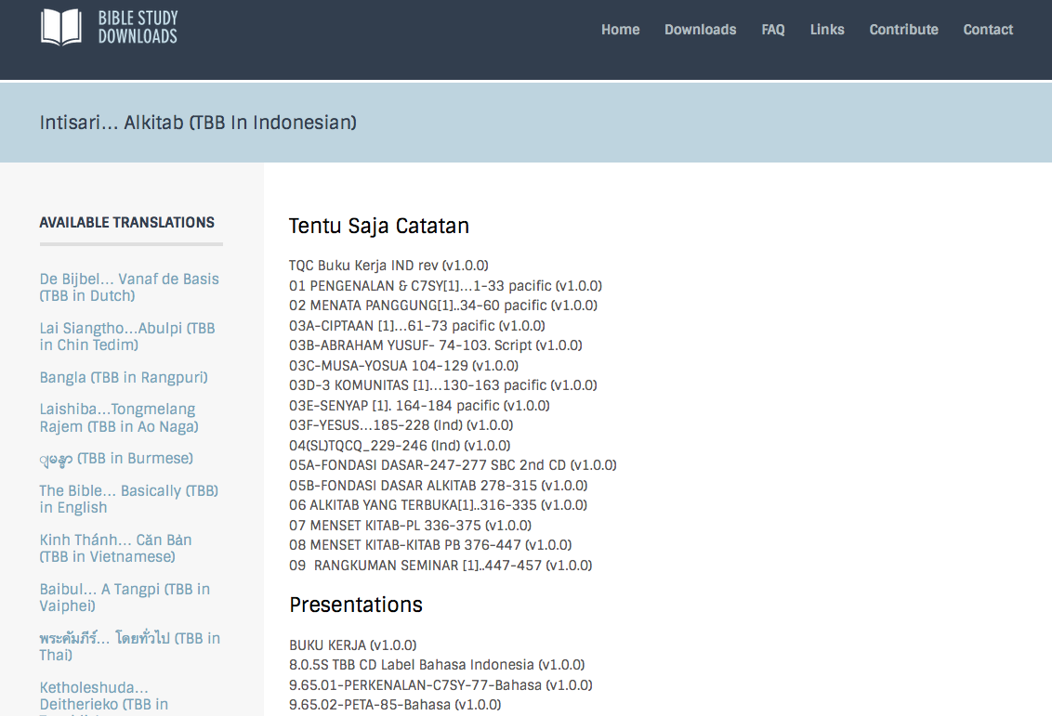
Bahasa Indonesia
BibleStudyDownloads.org

Slide 23
TBB

Slide 24
TBB Vision

Slide 25
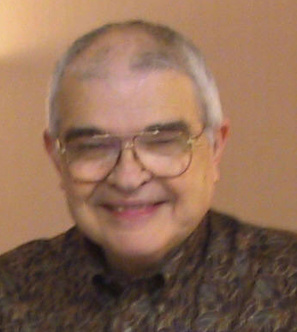
Dr John Fryman
Dr. John Fryman
Author of The Bible…Basically 10-Hour Seminar Fort Worth, Texas
www.biblebasically.org
©2004 TBBMI
8.0.01.
04

Slide 26
English

Slide 27
Burmese
Lai S iangtho…Abulpi
A Presentation of The Bible…Basically Ministries International Inc. Fort Worth, Texas
www.biblebasically.com
©2004 TBBMI
8.0.01.
04

Slide 28
French
LA BIBLE…
EN BASE
Une Présentation du Ministère Internationale de La Bible… En Base Inc. Fort Worth, Texas
www.biblebasically.com
©2006 TBBMI
8.0.01.
04
©2004 TBBMI
9.6.01.

Slide 29
Japanese
バイブル ベイシックミニストリーズ
インスティチュート
A Presentation of The Bible…Basically Ministries International Inc. Fort Worth, Texas
www.biblebasically.com
©2004 TBBMI
8.0.01.
04
Notes:
Japanese title slide

Slide 30
Khmer (Cambodian)
mUldæanRKwH>>>
énRBHKm<IIr
karbgðaj[sÁal;nUvRBHKm<Ir>>> EdlCamUldæanRKw³ kñúg B½n§kic©shKmnGnþrCati GayGinsIu.
Fort Worth, Texas
www.biblebasically.com
©2004 TBBMI
8.0.01.
04

Slide 31
Korean
성경은 … 기본적으로
A Presentation of The Bible…Basically Ministries International Inc. Fort Worth, Texas
www.biblebasically.com
7.5.01.
©2003 TBBMI
04

Slide 32
Malay
Alkitab… Dasar
Presentasi dari The Bible…Basically Ministries International Inc. Fort Worth, Texas
www.biblebasically.com
©2004 TBBMI
8.0.01.
04

Slide 33
Mao (India)
Bible…
Amolo Leino
Bible…Ngashankakhuina Ministries International Inc. pashina semkashok Fort Worth, Texas
www.biblebasically.com
©2004 TBBMI
8.0.01.
04

Slide 34
Malayalam (India)
Æß èÌÌßZ çÌØßAÜß
¥ÕÄøßMßAáKÄí Æß èÌÌßZ çÌØßAÜß… ÎßÈßØíd¿àØí §aVÈÞ×ÃW çËÞVGíÕVJí, æ¿µíØÞØí
©2004 TBBMI
8.0.01.
04

Slide 35
Mongolian
Библи… Үндсэндээ
A Presentation of The Bible…Basically Ministries International Inc. Fort Worth, Texas
www.biblebasically.com
©2004 TBBMI
8.0.01.
04

Slide 36
Nepali
afOan======
cfwf/e[\t
A Presentation of The Bible…Basically Ministries International Inc. Fort Worth, Texas
www.biblebasically.com
8.0.01.
©2004 TBBMI
04

Slide 37
Swahili (Kenya)
biblia kwa ujumla
A Presentation of The Bible…Basically Ministries International Inc. Fort Worth, Texas
www.biblebasically.com
8.0.01.
©2003 TBBMI
04

Slide 38
Tagalog (Philippines)
Ang Biblia . . . Pinasimple
A Presentation of The Bible…Basically Ministries International Inc. Fort Worth, Texas
www.biblebasically.com
©2004 TBBMI
8.0.01.
04
Notes:
PLEASE PUT THE TITLE AND SUBTITLES INTO YOUR NATIONAL LANGUAGE AND LEAVE THE WEBSITE UNCHANGED

Slide 39
Tangkhul (India)
Bible…
Ngashankakhui
Bible…Ngashankakhuina Ministries International Inc. pashina semkashok Fort Worth, Texas
www.biblebasically.com
©2004 TBBMI
8.0.01.
04

Slide 40
Tamil (Sri Lanka/India)
jpUkiwapd;… mbg;gil
A Presentation of The Bible…Basically Ministries International Inc. Fort Worth, Texas
www.biblebasically.com
©2004 TBBMI
8.0.01.
04

Slide 41
Vietnamese
Kinh thánh… Cơ bản là
A Presentation of The Bible…Basically Ministries International Inc. Fort Worth, Texas
www.biblebasically.com
©2004 TBBMI
8.0.01.
04

Slide 42
Bahasa Indonesia
Presentasi dari The Bible…Basically Ministries International Inc. Fort Worth, Texas
www.biblebasically.com
7.5.01.
©2003 TBBMI
04

Slide 43
Chinese (Mandarin)
圣经...
基要
国际基本事工呈献…圣经纵览系列. 福特沃得, 德州
www.biblebasically.com
8.0.01.
©2003 TBBMI
04

Slide 44
PowerPoint (945 slides) Student Workbook (100 pages) Teacher Script (400 pages)
TBB Materials
Completed in English • Bahasa • Chinese • Hindi • Malay • Korean • Mongolian • Russian • Spanish
A Presentation of The Bible…Basically Ministries International Inc. Fort Worth, Texas
www.biblebasically.org
©2004 TBBMI
8.0.01.
04

Slide 45
The Bible…Basically link at BibleStudyDownloads.org
Get this presentation for free!
Notes:
The Bible…Basically (bb)

Slide 46
Black
1
4
2
5
3
6

